Slide 1
Review Report for Amazon Musical Instruments
Created 19-07-2023 [By-Syed Akif]

Slide 2
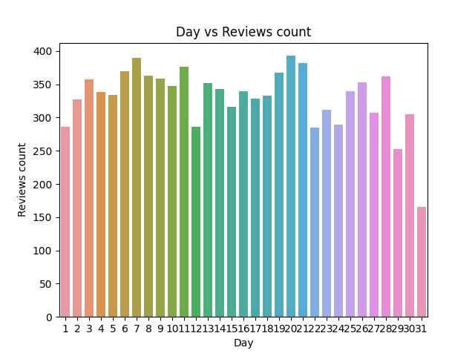

Slide 3
